Slide 1
LIBRARY
MANAGEMENT SYSTEM
Prepared by:
Supriya
Gopi
Lalith babu
Madhumitha
Srinidhi

Slide 2
Contents
Introduction
Purpose
Project Scope
Product Functions
Hardware Interface
Software Interface
Performance Requirements
Safety Requirements
Security Requirements
Analysis Model

Slide 3
Introduction
The project “ Online Library Management System” is developed in Java, which mainly focuses on basic operations in a library like adding new member, new books, and updating new information, searching books and members and facility to issue and return books. Using this web application user can make the booking of books online and can look for the book either it is available in library or not.

Slide 4
Purpose
1. It provides "better and efficient" service to members.
2. Reduce the workload of librarian.
3. Faster retrieval of information about the desired book.
4. Provide facility for proper monitoring reduce paper work
and provide data security.
5. All details will be available on a click for both user and librarian.

Slide 5
Product Scope
Any educational institute & government offices.
This project can be further extended by adding more features.

Slide 6
Product Functions
The functions of the system include the system providing the different types of services based on the type of users.
User accounts with login facilities.
Provide updated information about books through mails.
List will be automatically updated.
Librarian get Information about the members and books.

Slide 7
Hardware & Software Interface
Hardware:
Processor: Pentium 3.0 GHz or higher
RAM: 512 mb or more
Hard drive: 10 GB or more
Software:
windows 7 or more
Java
Oracle
JDBC
Eclipse IDE

Slide 8
Performance Requirement
The proposed system will be as the Chief performance system within the library of the institute which interact with the institute’s staff and students.
Therefore ,it is expected that the database would perform functionally all the requirements that are specified by the institute.
The system shall accommodate high number of books and users without any fault.

Slide 9
Safety Requirement
The database may get trashed at any certain time due to virus or operating system failure.
Therefore, it is required to take the database backup.

Slide 10
Security Requirement
Secured database
Depending upon the category of user the access rights are decided .
If the user is an administrator then he can be able to modify the data , delete ,append etc.
All the other users other than administrator only have the rights to retrieve the information about the database.

Slide 11
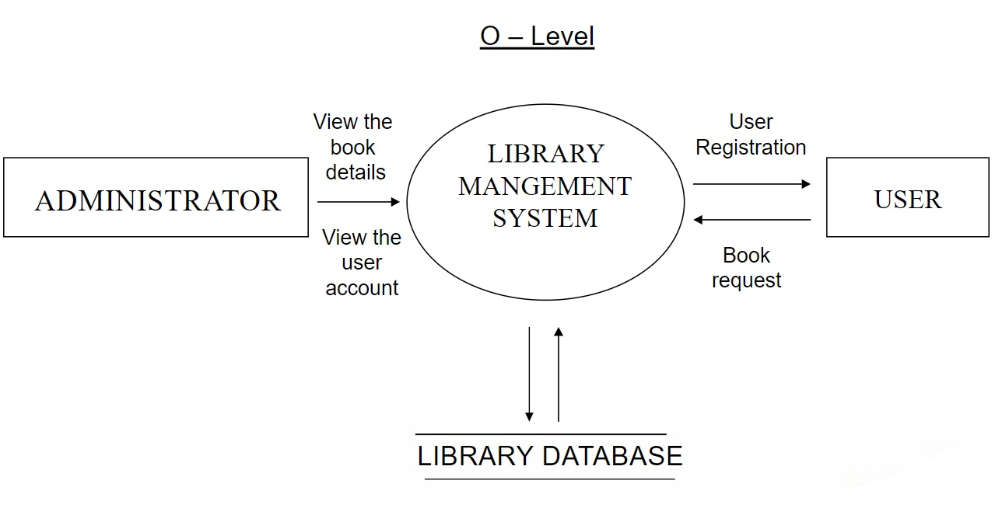
Analysis Model

Slide 12
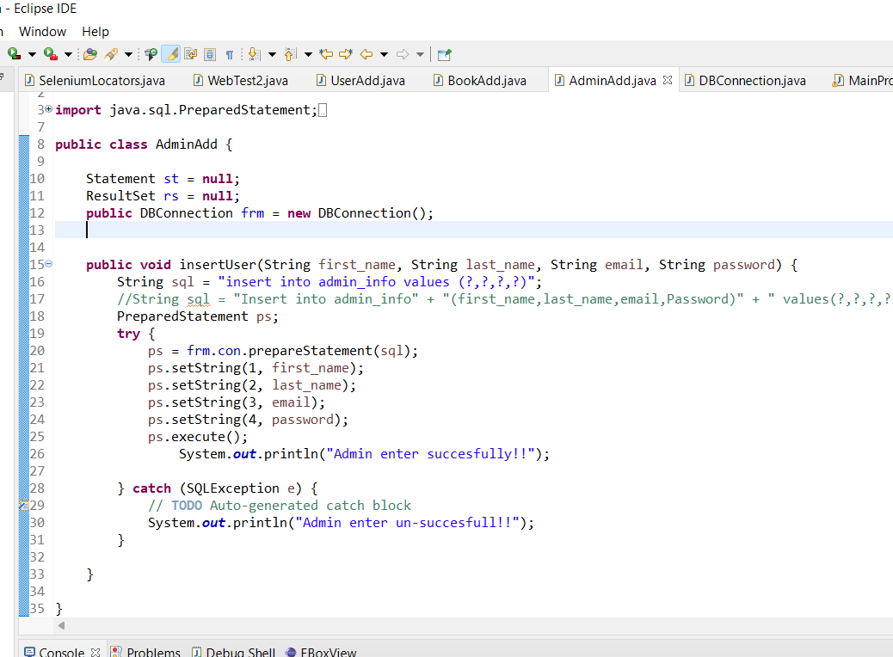
Snapshots of code

Slide 13
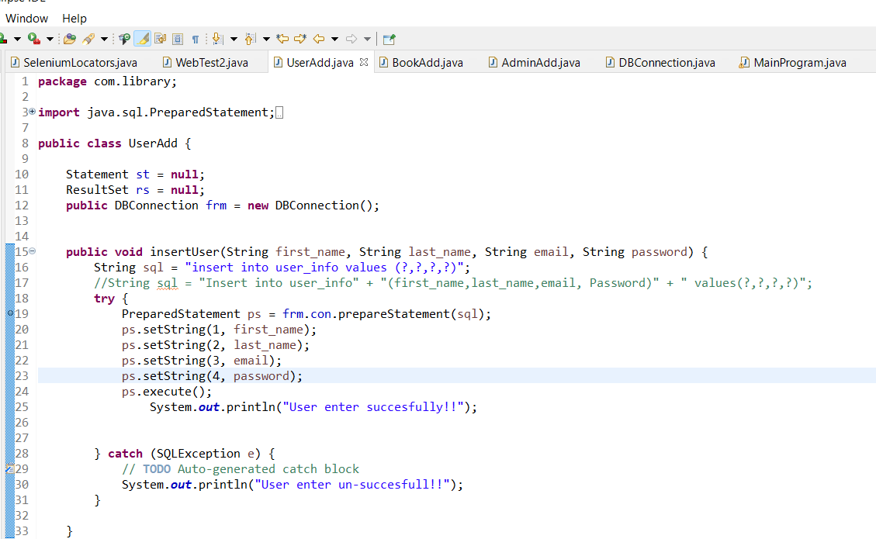

Slide 14
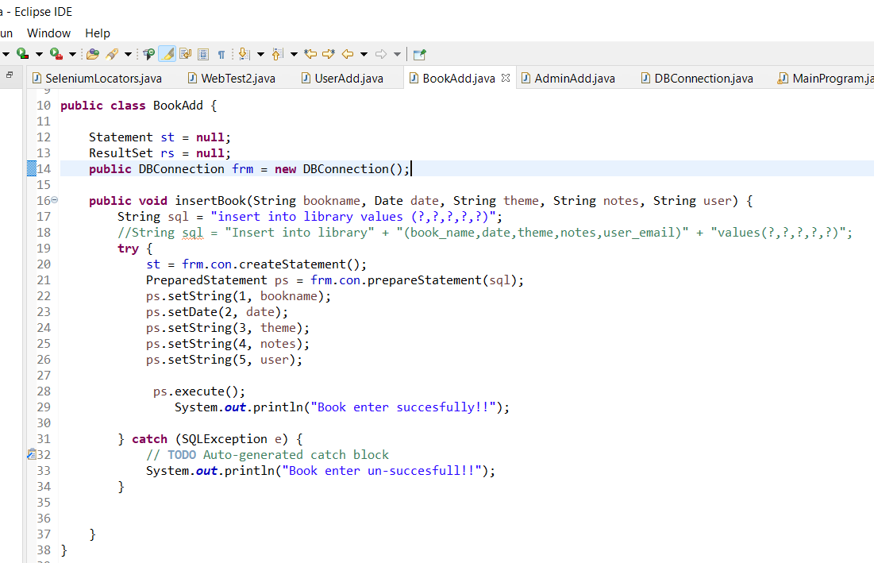

Slide 15
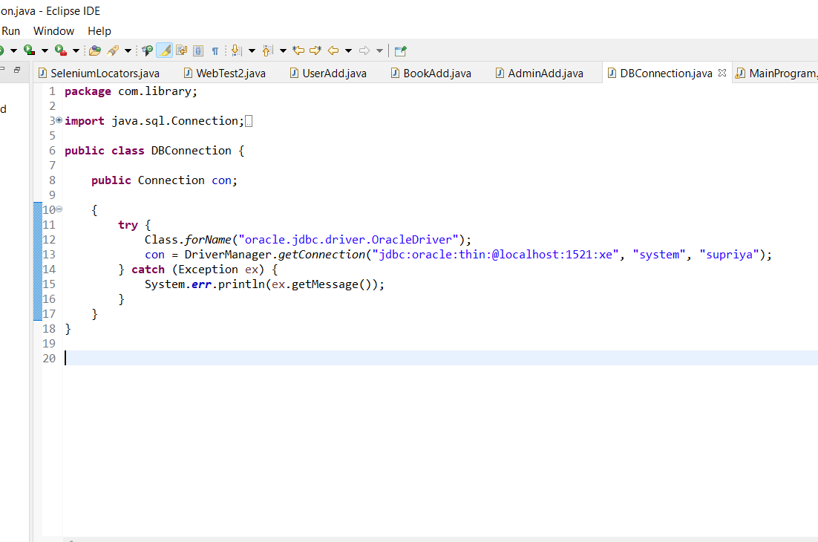

Slide 16
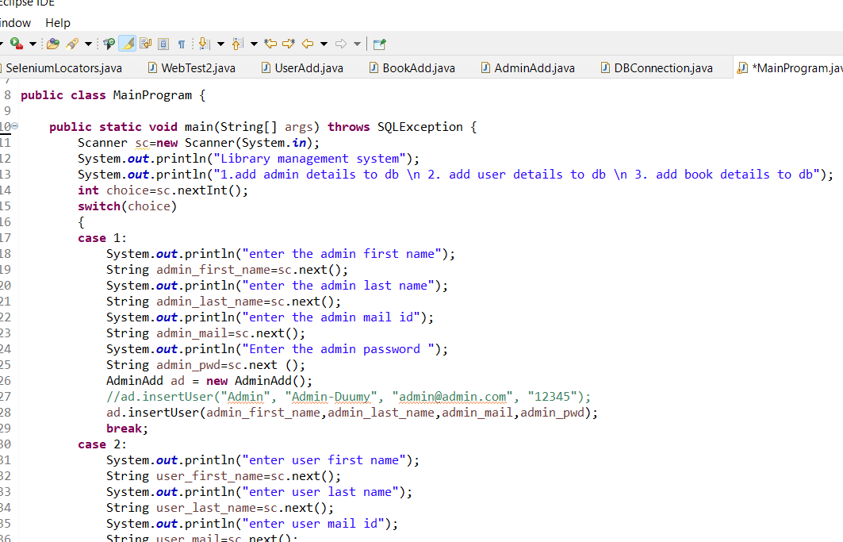

Slide 17
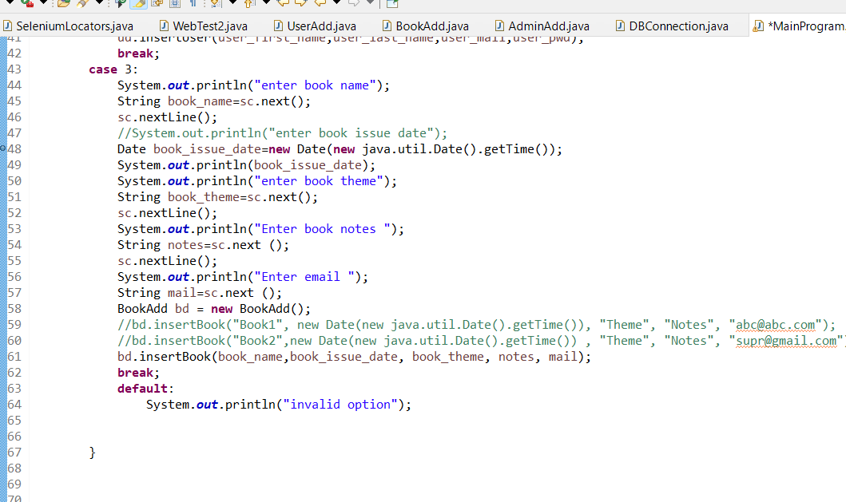

Slide 18
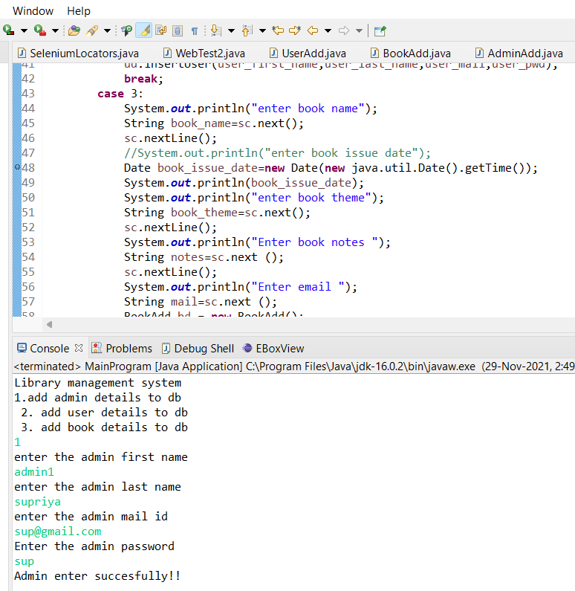

Slide 19
Conclusion
This software allows storing the details of all the data related to the library.
The implementation of the system will reduce data entry time and provide readily calculated reports.

Slide 20
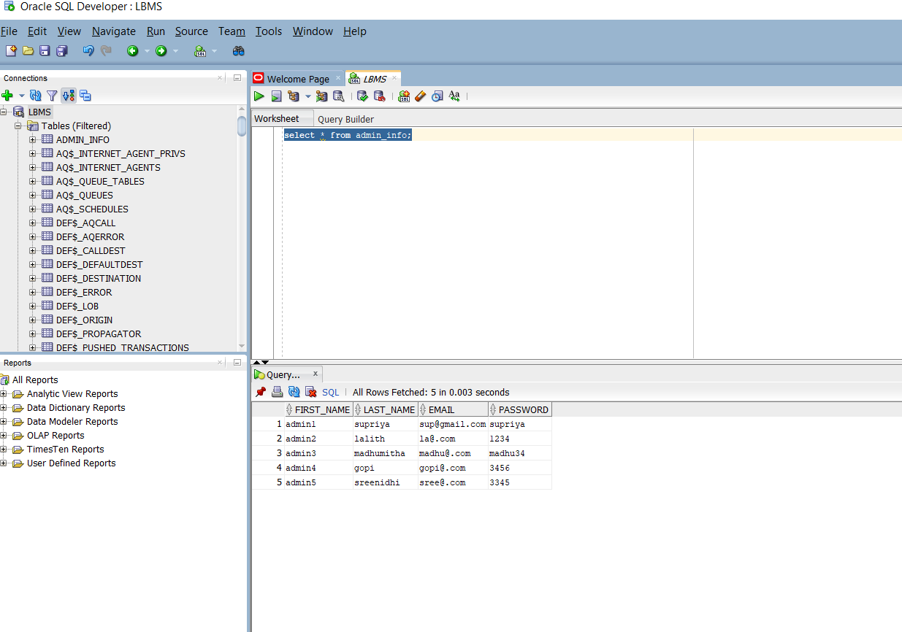

Slide 21
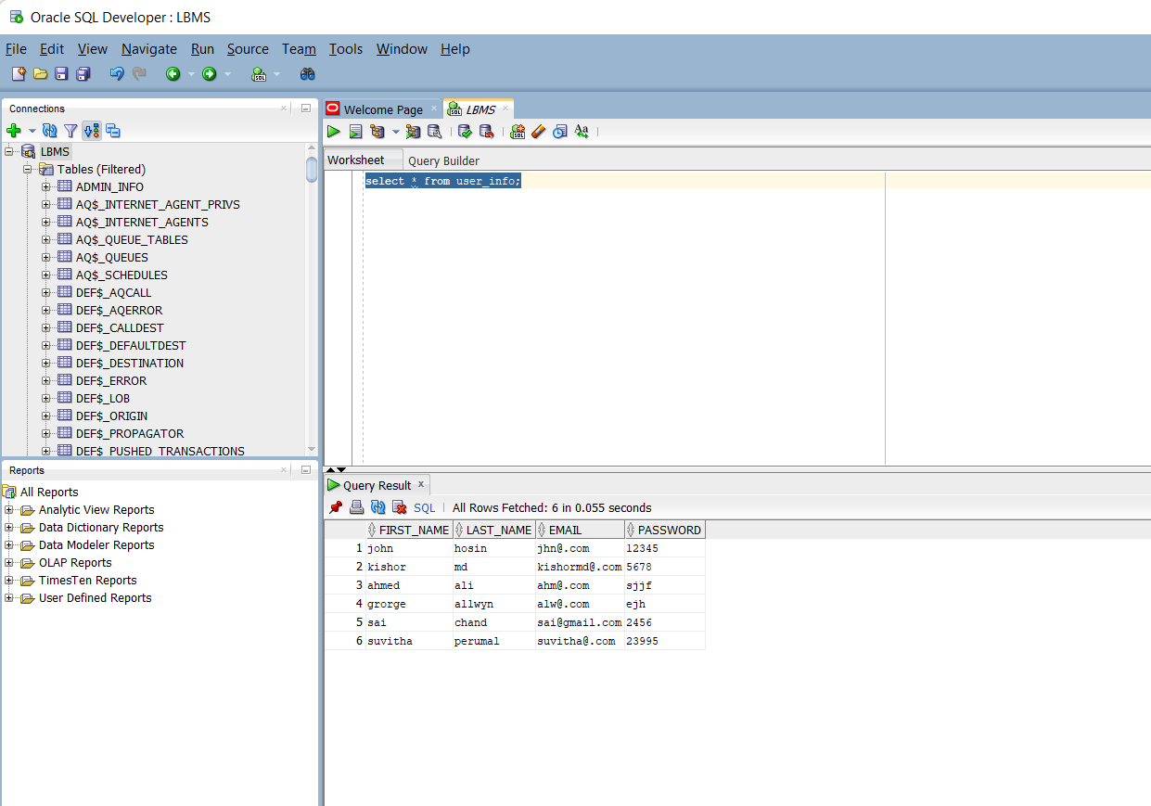

Slide 22
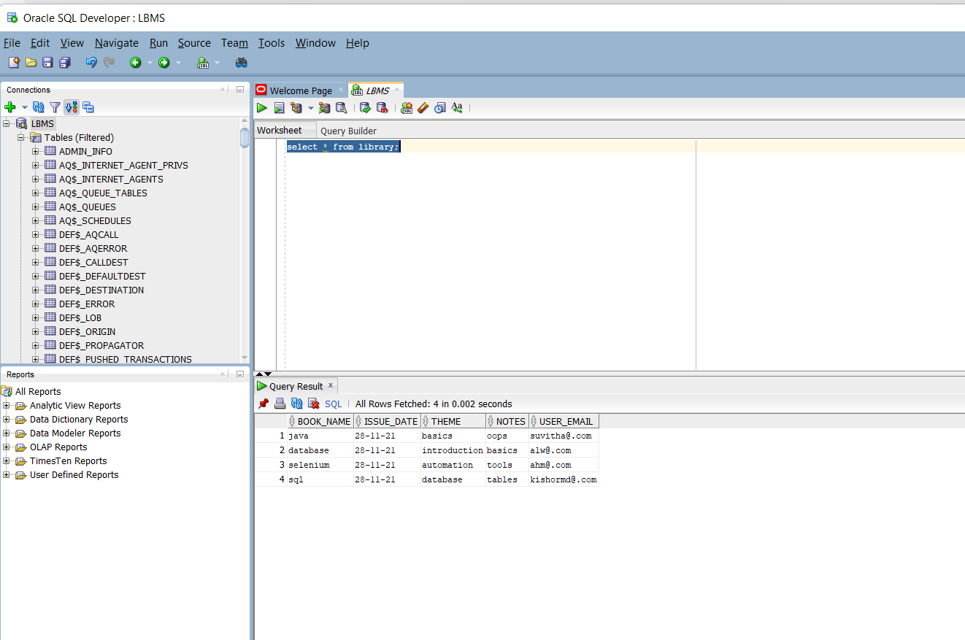

Slide 23
Automation Testing of ABCShop project
Prepared by:
Lalith Babu
Gopi Krishnan
Supriya
Madhumitha
Srinidhu

Slide 24
Contents
Introduction
Automation framework
Automation using selenium
Junit
TestNG
Cross browser testing
Extent reports

Slide 25
Introduction
The objective of the project is to automate some of the operations using the automation tools .
The aim of frameworks is to provide a common structure so that developers don't have to redo it from scratch and can reuse the code provided.
In this way, frameworks allow us to cut out much of the work and save a lot of time.

Slide 26
What is Automation framework?
Automation Framework is not a single tool or process, but it is a collection of tools and processes working together to support automated testing of any application. It integrates various functions like libraries, test data, and various reusable modules.
Increasing Productivity
Increasing Quality
Reducing Cost
Increasing Safety in Working conditions.

Slide 27
Automation using selenium
Selenium refers to a suite of tools that are widely used in the testing community when it comes to cross-browser testing.
Selenium cannot automate desktop applications; it can only be used in browsers.
It is considered to be one of the most preferred tool suites for automation testing of web applications as it provides support for popular web browsers which makes it very powerful.

Slide 28
Junit
A JUnit test annotation is basically meta-data that JUnit provides to determine what action should be performed by a method.
It allows developers to organize, group, and maintain test cases. Selenium allows integration with JUnit.
To combine the two, one has to write Selenium test code within JUnit test

Slide 29
TestNG
TestNG is an automation testing framework in which NG stands for “Next Generation”.
TestNG is inspired by JUnit which uses the annotations (@).
TestNG overcomes the disadvantages of JUnit and is designed to make end-to-end testing easy.

Slide 30
Cross browser testing
Cross Browser Testing is a type of functional test to check that your web application works as expected in different browsers.
Web-based applications are totally different from Windows applications. A web application can be opened in any browser by the end user.

Slide 31
Extent reports
Extent Reports is an open-source reporting library useful for test automation. It can be easily integrated with major testing frameworks like JUnit, NUnit, TestNG, etc.
Once an automated test script runs successfully, testers need to generate a test execution report. While TestNG does provide a default report, they do not provide the details.

Slide 32
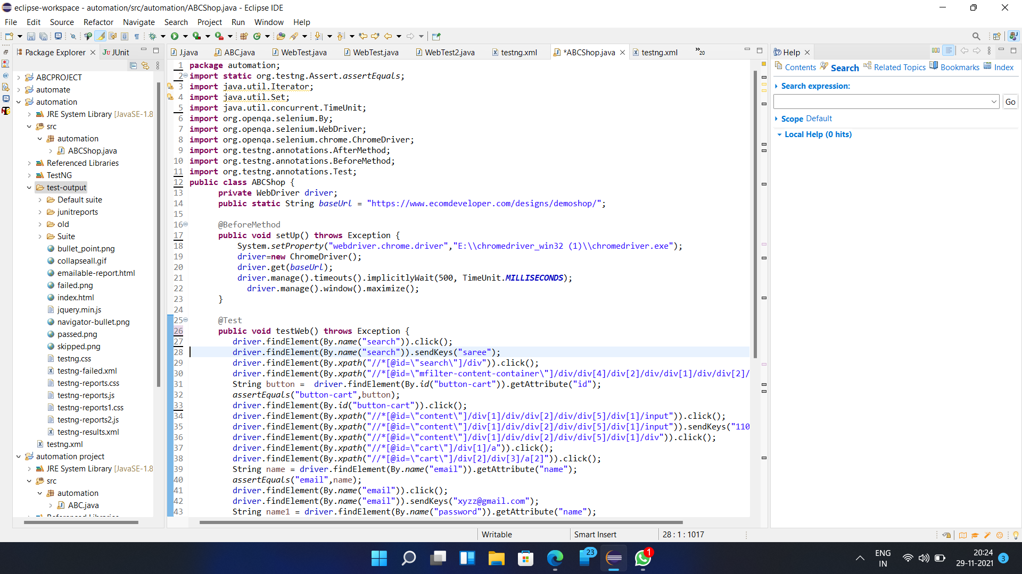

Slide 33
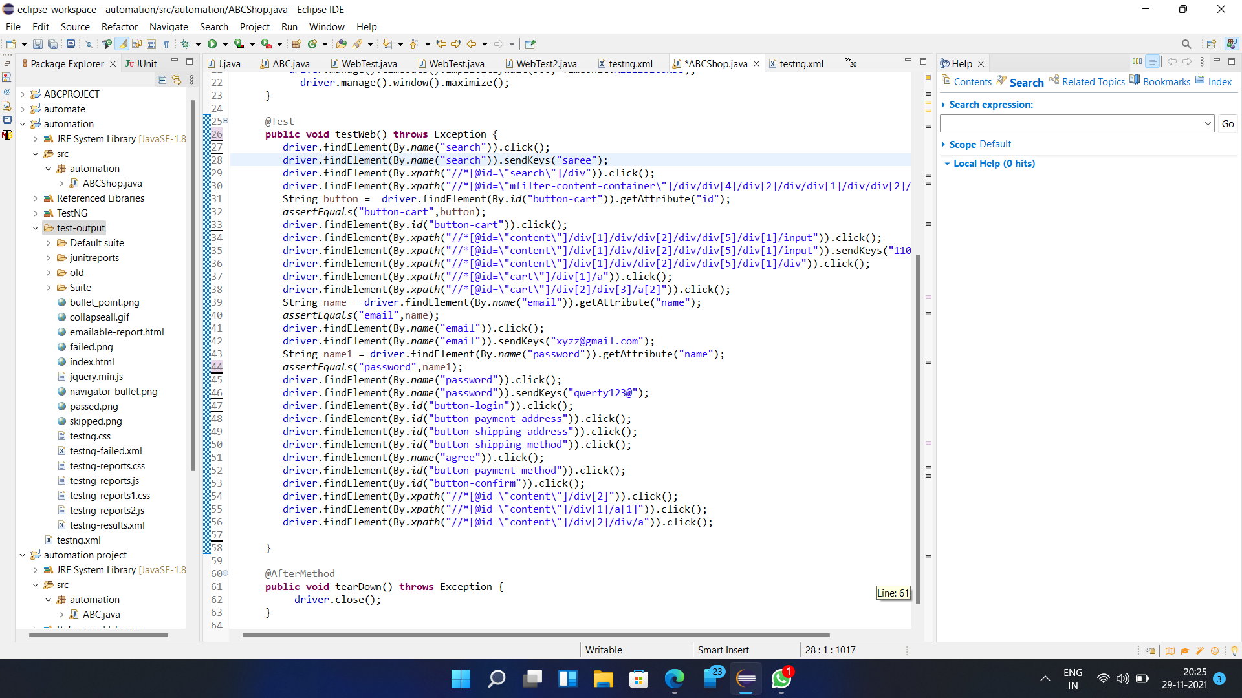

Slide 34
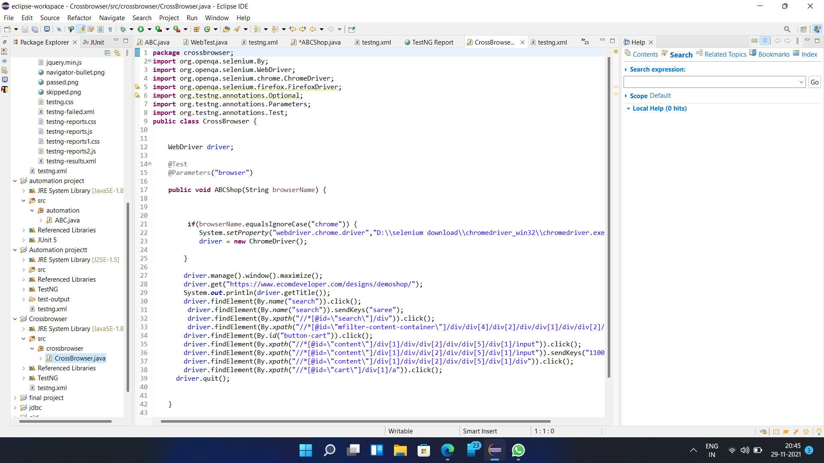

Slide 35
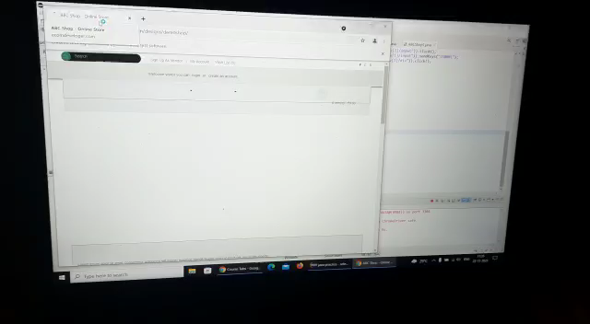
Demonstration

Slide 36
GitHub links for the projects
GitHub link for library management system project:
https://github.com/GopiKrishnanM57/teampeakperformers
GitHub link for ABCShop automation project:
https://github.com/GopiKrishnanM57/peakperformersautomation

Slide 37
MANUAL TESTING
ABC SHOP
COVER PAGE
 | Prepared By | Reviewed By | Approved By
ID | HCLTSS_105,HCLTSS_107 | HCLTSS_125,HCLTSS_100 | HCLTSSM_101
Name | Madhumitha,Srinidhi | LalithBabu,Gopi | Supriya
Role | Tester | Test Lead | Test Manager
Date | 25-11-2021 | 26-11-2021 | 29-11-2021
Signature

Slide 38
Test Scenario -ABC SHOP.
Module | Scenerio_id | Scenerio_name | Scenerio_Description | Reference Document | Requirement_ID
Register Account | TS_ABCS_RA_01 | Application Registeration With Valid Details | Register for ABC shop using Valid data | SRS 1.0 | R01
Register Account | TS_ABCS_RA_02 | Application Registeration With In Valid Details | Register for ABC shop using InValid data | SRS 1.0 | R01
Register Account | TS_ABCS_RA_03 | Check for the field Validation | Validation the fields of Application Form | SRS 1.0 | RO2

Slide 39
Test Scenerio_id | Test Case_id | Test Case Description | Pre-requisite | Test Data Parameters | Steps to be Executed | Test data | Expected Result | Actual Result | Test Result | Defect_id | Remarks | Priority
TS_ABCS_RA_01 | TC_ABCS_RA_01 | To check whether application is able to register with valid details | To have stable internet Connection. |  | Step 1: Enter the Browser. | Google Chrome | Browser will be open. | Browser opened. | PASS
 |  |  |  |  | Step 2: Enter the URL. | https://www.ecomdeveloper.com/designs/demoshop/index.php?route=account/register | URL will Launch. | URL was Launched
 |  |  |  | <<TextBox>> | Step 4: Enter First Name | sai | sai will be launched | sai was displayed.
 |  |  |  | <<TextBox>> | Step 5:Enter Last Name | kumar | kumar will be launched. | kumar was displayed.
 |  |  |  | <<TextBox>> | Step 6:Enter E-Mail | saikumar@gmail.com | email will be launched. | email was displayed.
 |  |  |  | <<TextBox>> | Step 7:Enter Telephone | 9568565841 | Telephone will be launched. | Telephone was displayed.
 |  |  |  | <<TextBox>> | Step 8: Enter Fax | 1234567891 | Fax be launched. | Fax was displayed.
 |  |  |  | <<TextBox>> | Step 10: Company | IBM | Company will be launched. | Company was displayed.
 |  |  |  | <<TextBox>> | Step 11:Company ID | IBM001 | Company ID will be launched. | Company ID was displayed.
 |  |  |  | <<TextBox>> | Step 12:Address 1 | Nellore | Address 1 will be launched. | Address 1 was displayed.
 |  |  |  | <<TextBox>> | Step 13:Address 2. | Tirupati | Address 2 will be launched. | Address 2 was displayed.
 |  |  |  | <<TextBox>> | Step 14: City | andhrapradesh | City will be launched. | City was displayed.
 |  |  |  | <<TextBox>> | Step 15:Post Code | 625010 | Post Code will be launched. | Post Code was displayed.
 |  |  |  | <<DropDown>> | Step 16: Country | India | Country will be launched. | Country was displayed.
 |  |  |  | <<DropDown>> | Step 17: Region / State | Tamilnadu | Region / State will be launched. | Region / State was displayed.
 |  |  |  | <<TextBox>> | Step 19: Password | sai*123 | Password will be launched. | Password launched.
 |  |  |  | <<TextBox>> | Step 20: Password Confirm | sai*123 | Password Confirm will be launched. | Password Confirm launched
 |  |  |  | <<Radiobutton>> | Step 22:Subscribe: | clicked
 |  |  |  | <<Checkbox>> | Step 23:I have read and agree to the Privacy Policy | checked
 |  |  |  | <<Button>> | Step 24: Continue | clicked | It will displays"The account has been created" | It will displays"The account has been created"

Slide 40
TS_ABCS_RA_02 | TC_ABCS_RA_02 | To check whether application is able to register with invalid details | To have stable internet Connection. |  | Step 1: Enter the Browser. | Google Chrome | Browser will be open. | Browser opened. | FAIL | DEF_001 | Instead of creating the account it displays error message | High
 |  |  |  |  | Step 2: Enter the URL. | https://www.ecomdeveloper.com/designs/demoshop/index.php?route=account/register | URL will Launch. | URL was Launched
 |  |  |  | <<TextBox>> | Step 4: Enter First Name |  | sai will not be launched | sai was not displayed.
 |  |  |  | <<TextBox>> | Step 5:Enter Last Name | kumar | kumar will be launched. | kumar was displayed.
 |  |  |  | <<TextBox>> | Step 6:Enter E-Mail | saikumar@gmail.com | email will be launched. | email was displayed.
 |  |  |  | <<TextBox>> | Step 7:Enter Telephone | 9568565841 | Telephone will be launched. | Telephone was displayed.
 |  |  |  | <<TextBox>> | Step 8: Enter Fax |  | Fax be launched. | Fax was displayed.
 |  |  |  | <<TextBox>> | Step 10: Company | IBM | Company will be launched. | Company was displayed.
 |  |  |  | <<TextBox>> | Step 11:Company ID | IBM001 | Company ID will be launched. | Company ID was displayed.
 |  |  |  | <<TextBox>> | Step 12:Address 1 | Nellore | Address 1 will be launched. | Address 1 was displayed.
 |  |  |  | <<TextBox>> | Step 13:Address 2. | Tirupati | Address 2 will be launched. | Address 2 was displayed.
 |  |  |  | <<TextBox>> | Step 14: City | andhrapradesh | City will be launched. | City was displayed.
 |  |  |  | <<TextBox>> | Step 15:Post Code |  | Post Code will be launched. | Post Code was displayed.
 |  |  |  | <<DropDown>> | Step 16: Country | India | Country will be launched. | Country was displayed.
 |  |  |  | <<DropDown>> | Step 17: Region / State |  | Region / State will be launched. | Region / State was displayed.
 |  |  |  | <<TextBox>> | Step 19: Password | sai*123 | Password will be launched. | Password launched.
 |  |  |  | <<TextBox>> | Step 20: Password Confirm | sai*123 | Password Confirm will be launched. | Password Confirm launched
 |  |  |  | <<Radiobutton>> | Step 22:Subscribe: | clicked
 |  |  |  | <<Checkbox>> | Step 23:I have read and agree to the Privacy Policy | checked
 |  |  |  | <<Button>> | Step 24: Continue | clicked | It will display Error message | It will displays"The account has been created"

Slide 41
TS_ABCS_RA_02 | TC_ABCS_RA_03 | To check whether application is able to register with invalid details | To have stable internet Connection. |  | Step 1: Enter the Browser. | Google Chrome | Browser will be open. | Browser opened. | FAIL | DEF_002 | Instead of creating the account it displays error message | High
 |  |  |  |  | Step 2: Enter the URL. | https://www.ecomdeveloper.com/designs/demoshop/index.php?route=account/register | URL will Launch. | URL was Launched
 |  |  |  | <<TextBox>> | Step 4: Enter First Name | Sai | sai will be launched | sai was displayed.
 |  |  |  | <<TextBox>> | Step 5:Enter Last Name |  | kumar will not be launched. | kumar was not displayed.
 |  |  |  | <<TextBox>> | Step 6:Enter E-Mail | saikumar@gmail.com | email will be launched. | email was displayed.
 |  |  |  | <<TextBox>> | Step 7:Enter Telephone | 9568565841 | Telephone will be launched. | Telephone was displayed.
 |  |  |  | <<TextBox>> | Step 8: Enter Fax |  | Fax be launched. | Fax was displayed.
 |  |  |  | <<TextBox>> | Step 10: Company | IBM | Company will be launched. | Company was displayed.
 |  |  |  | <<TextBox>> | Step 11:Company ID | IBM001 | Company ID will be launched. | Company ID was displayed.
 |  |  |  | <<TextBox>> | Step 12:Address 1 | Nellore | Address 1 will be launched. | Address 1 was displayed.
 |  |  |  | <<TextBox>> | Step 13:Address 2. | Tirupati | Address 2 will be launched. | Address 2 was displayed.
 |  |  |  | <<TextBox>> | Step 14: City | andhrapradesh | City will be launched. | City was displayed.
 |  |  |  | <<TextBox>> | Step 15:Post Code |  | Post Code will be launched. | Post Code was displayed.
 |  |  |  | <<DropDown>> | Step 16: Country | India | Country will be launched. | Country was displayed.
 |  |  |  | <<DropDown>> | Step 17: Region / State |  | Region / State will be launched. | Region / State was displayed.
 |  |  |  | <<TextBox>> | Step 19: Password | sai*123 | Password will be launched. | Password launched.
 |  |  |  | <<TextBox>> | Step 20: Password Confirm | sai*123 | Password Confirm will be launched. | Password Confirm launched
 |  |  |  | <<Radiobutton>> | Step 22:Subscribe: | clicked
 |  |  |  | <<Checkbox>> | Step 23:I have read and agree to the Privacy Policy | checked
 |  |  |  | <<Button>> | Step 24: Continue | clicked | It will display Error message | It will displays"The account has been created"

Slide 42
TS_ABCS_RA_02 | TC_ABCS_RA_04 | To check whether application is able to register with invalid details | To have stable internet Connection. |  | Step 1: Enter the Browser. | Google Chrome | Browser will be open. | Browser opened. | PASS
 |  |  |  |  | Step 2: Enter the URL. | https://www.ecomdeveloper.com/designs/demoshop/index.php?route=account/register | URL will Launch. | URL was Launched
 |  |  |  | <<TextBox>> | Step 4: Enter First Name | sai | sai will be launched | sai was displayed.
 |  |  |  | <<TextBox>> | Step 5:Enter Last Name | kumar | kumar will be launched. | kumar was displayed.
 |  |  |  | <<TextBox>> | Step 6:Enter E-Mail |  | email will not be launched. | email was not displayed.
 |  |  |  | <<TextBox>> | Step 7:Enter Telephone | 9568565841 | Telephone will be launched. | Telephone was displayed.
 |  |  |  | <<TextBox>> | Step 8: Enter Fax |  | Fax be launched. | Fax was displayed.
 |  |  |  | <<TextBox>> | Step 10: Company | IBM | Company will be launched. | Company was displayed.
 |  |  |  | <<TextBox>> | Step 11:Company ID | IBM001 | Company ID will be launched. | Company ID was displayed.
 |  |  |  | <<TextBox>> | Step 12:Address 1 | Nellore | Address 1 will be launched. | Address 1 was displayed.
 |  |  |  | <<TextBox>> | Step 13:Address 2. | Tirupati | Address 2 will be launched. | Address 2 was displayed.
 |  |  |  | <<TextBox>> | Step 14: City | andhrapradesh | City will be launched. | City was displayed.
 |  |  |  | <<TextBox>> | Step 15:Post Code |  | Post Code will be launched. | Post Code was displayed.
 |  |  |  | <<DropDown>> | Step 16: Country | India | Country will be launched. | Country was displayed.
 |  |  |  | <<DropDown>> | Step 17: Region / State |  | Region / State will be launched. | Region / State was displayed.
 |  |  |  | <<TextBox>> | Step 19: Password | sai*123 | Password will be launched. | Password launched.
 |  |  |  | <<TextBox>> | Step 20: Password Confirm | sai*123 | Password Confirm will be launched. | Password Confirm launched
 |  |  |  | <<Radiobutton>> | Step 22:Subscribe: | clicked
 |  |  |  | <<Checkbox>> | Step 23:I have read and agree to the Privacy Policy | checked
 |  |  |  | <<Button>> | Step 24: Continue | clicked | It will display Error message | It displayed Error message

Slide 43
TS_ABCS_RA_02 | TC_ABCS_RA_05 | To check whether application is able to register with invalid details | To have stable internet Connection. |  | Step 1: Enter the Browser. | Google Chrome | Browser will be open. | Browser opened. | PASS
 |  |  |  |  | Step 2: Enter the URL. | https://www.ecomdeveloper.com/designs/demoshop/index.php?route=account/register | URL will Launch. | URL was Launched
 |  |  |  | <<TextBox>> | Step 4: Enter First Name | sai | sai will be launched | sai was displayed.
 |  |  |  | <<TextBox>> | Step 5:Enter Last Name | kumar | kumar will be launched. | kumar was displayed.
 |  |  |  | <<TextBox>> | Step 6:Enter E-Mail | saikumar@gmail.com | email will be launched. | email was displayed.
 |  |  |  | <<TextBox>> | Step 7:Enter Telephone |  | Telephone will not be launched. | Telephone was not displayed.
 |  |  |  | <<TextBox>> | Step 8: Enter Fax |  | Fax be launched. | Fax was displayed.
 |  |  |  | <<TextBox>> | Step 10: Company | IBM | Company will be launched. | Company was displayed.
 |  |  |  | <<TextBox>> | Step 11:Company ID | IBM001 | Company ID will be launched. | Company ID was displayed.
 |  |  |  | <<TextBox>> | Step 12:Address 1 | Nellore | Address 1 will be launched. | Address 1 was displayed.
 |  |  |  | <<TextBox>> | Step 13:Address 2. | Tirupati | Address 2 will be launched. | Address 2 was displayed.
 |  |  |  | <<TextBox>> | Step 14: City | andhrapradesh | City will be launched. | City was displayed.
 |  |  |  | <<TextBox>> | Step 15:Post Code |  | Post Code will be launched. | Post Code was displayed.
 |  |  |  | <<DropDown>> | Step 16: Country | India | Country will be launched. | Country was displayed.
 |  |  |  | <<DropDown>> | Step 17: Region / State |  | Region / State will be launched. | Region / State was displayed.
 |  |  |  | <<TextBox>> | Step 19: Password | sai*123 | Password will be launched. | Password launched.
 |  |  |  | <<TextBox>> | Step 20: Password Confirm | sai*123 | Password Confirm will be launched. | Password Confirm launched
 |  |  |  | <<Radiobutton>> | Step 22:Subscribe: | clicked
 |  |  |  | <<Checkbox>> | Step 23:I have read and agree to the Privacy Policy | checked
 |  |  |  | <<Button>> | Step 24: Continue | clicked | It will display Error message | It displayed Error message

Slide 44
TS_ABCS_RA_01 | TC_ABCS_RA_06 | To check whether application is able to register with invalid details | To have stable internet Connection. |  | Step 1: Enter the Browser. | Google Chrome | Browser will be open. | Browser opened. | PASS
 |  |  |  |  | Step 2: Enter the URL. | https://www.ecomdeveloper.com/designs/demoshop/index.php?route=account/register | URL will Launch. | URL was Launched
 |  |  |  | <<TextBox>> | Step 4: Enter First Name | sai | sai will be launched | sai was displayed.
 |  |  |  | <<TextBox>> | Step 5:Enter Last Name | kumar | kumar will be launched. | kumar was displayed.
 |  |  |  | <<TextBox>> | Step 6:Enter E-Mail | saikumar@gmail.com | email will be launched. | email was displayed.
 |  |  |  | <<TextBox>> | Step 7:Enter Telephone | 9568565841 | Telephone willbe launched. | Telephone was displayed.
 |  |  |  | <<TextBox>> | Step 8: Enter Fax |  | Fax will not be launched. | Fax was not displayed.
 |  |  |  | <<TextBox>> | Step 10: Company | IBM | Company will be launched. | Company was displayed.
 |  |  |  | <<TextBox>> | Step 11:Company ID | IBM001 | Company ID will be launched. | Company ID was displayed.
 |  |  |  | <<TextBox>> | Step 12:Address 1 | Nellore | Address 1 will be launched. | Address 1 was displayed.
 |  |  |  | <<TextBox>> | Step 13:Address 2. | Tirupati | Address 2 will be launched. | Address 2 was displayed.
 |  |  |  | <<TextBox>> | Step 14: City | andhrapradesh | City will be launched. | City was displayed.
 |  |  |  | <<TextBox>> | Step 15:Post Code |  | Post Code will be launched. | Post Code was displayed.
 |  |  |  | <<DropDown>> | Step 16: Country | India | Country will be launched. | Country was displayed.
 |  |  |  | <<DropDown>> | Step 17: Region / State |  | Region / State will be launched. | Region / State was displayed.
 |  |  |  | <<TextBox>> | Step 19: Password | sai*123 | Password will be launched. | Password launched.
 |  |  |  | <<TextBox>> | Step 20: Password Confirm | sai*123 | Password Confirm will be launched. | Password Confirm launched
 |  |  |  | <<Radiobutton>> | Step 22:Subscribe: | clicked
 |  |  |  | <<Checkbox>> | Step 23:I have read and agree to the Privacy Policy | checked
 |  |  |  | <<Button>> | Step 24: Continue | clicked | It will displays"The account has been created" | It will displays"The account has been created"

Slide 45
TS_ABCS_RA_03 | TC_ABCS_RA_07 | To check whether application is able to register with invalid details | To have stable internet Connection. |  | Step 1: Enter the Browser. | Google Chrome | Browser will be open. | Browser opened. | FAIL | DEF_003 | Instead of creating the account it displays error message | High
 |  |  |  |  | Step 2: Enter the URL. | https://www.ecomdeveloper.com/designs/demoshop/index.php?route=account/register | URL will Launch. | URL was Launched
 |  |  |  | <<TextBox>> | Step 4: Enter First Name | sai | sai will be launched | sai was displayed.
 |  |  |  | <<TextBox>> | Step 5:Enter Last Name | kumar | kumar will be launched. | kumar was displayed.
 |  |  |  | <<TextBox>> | Step 6:Enter E-Mail | saikumar | email will be launched. | email was displayed.
 |  |  |  | <<TextBox>> | Step 7:Enter Telephone | 9568565841 | Telephone willbe launched. | Telephone was displayed.
 |  |  |  | <<TextBox>> | Step 8: Enter Fax |  | Fax will be launched. | Fax was displayed.
 |  |  |  | <<TextBox>> | Step 10: Company | HCL | Company will be launched. | Company was displayed.
 |  |  |  | <<TextBox>> | Step 11:Company ID | IBM001 | Company ID will be launched. | Company ID was displayed.
 |  |  |  | <<TextBox>> | Step 12:Address 1 | Nellore | Address 1 will be launched. | Address 1 was displayed.
 |  |  |  | <<TextBox>> | Step 13:Address 2. | Tirupati | Address 2 will be launched. | Address 2 was displayed.
 |  |  |  | <<TextBox>> | Step 14: City | andhrapradesh | City will be launched. | City was displayed.
 |  |  |  | <<TextBox>> | Step 15:Post Code |  | Post Code will be launched. | Post Code was displayed.
 |  |  |  | <<DropDown>> | Step 16: Country | India | Country will be launched. | Country was displayed.
 |  |  |  | <<DropDown>> | Step 17: Region / State |  | Region / State will be launched. | Region / State was displayed.
 |  |  |  | <<TextBox>> | Step 19: Password | sai*123 | Password will be launched. | Password launched.
 |  |  |  | <<TextBox>> | Step 20: Password Confirm | sai*123 | Password Confirm will be launched. | Password Confirm launched
 |  |  |  | <<Radiobutton>> | Step 22:Subscribe: | clicked
 |  |  |  | <<Checkbox>> | Step 23:I have read and agree to the Privacy Policy | checked
 |  |  |  | <<Button>> | Step 24: Continue | clicked | It will display Error message | It will displays"The account has been created"

Slide 46
TS_ABCS_RA_03 | TC_ABCS_RA_08 | To check whether application is able to register with invalid details | To have stable internet Connection. |  | Step 1: Enter the Browser. | Google Chrome | Browser will be open. | Browser opened. | PASS
 |  |  |  |  | Step 2: Enter the URL. | https://www.ecomdeveloper.com/designs/demoshop/index.php?route=account/register | URL will Launch. | URL was Launched
 |  |  |  | <<TextBox>> | Step 4: Enter First Name | sai | sai will be launched | sai was displayed.
 |  |  |  | <<TextBox>> | Step 5:Enter Last Name | kumar | kumar will be launched. | kumar was displayed.
 |  |  |  | <<TextBox>> | Step 6:Enter E-Mail | saikumar@gmail.com | email will be launched. | email was displayed.
 |  |  |  | <<TextBox>> | Step 7:Enter Telephone | 9568565841 | Telephone willbe launched. | Telephone was displayed.
 |  |  |  | <<TextBox>> | Step 8: Enter Fax |  | Fax will be launched. | Fax was displayed.
 |  |  |  | <<TextBox>> | Step 10: Company | IBM | Company will be launched. | Company was displayed.
 |  |  |  | <<TextBox>> | Step 11:Company ID | gegfejhf | Company ID will be launched. | Company ID was displayed.
 |  |  |  | <<TextBox>> | Step 12:Address 1 | Nellore | Address 1 will be launched. | Address 1 was displayed.
 |  |  |  | <<TextBox>> | Step 13:Address 2. | Tirupati | Address 2 will be launched. | Address 2 was displayed.
 |  |  |  | <<TextBox>> | Step 14: City | andhrapradesh | City will be launched. | City was displayed.
 |  |  |  | <<TextBox>> | Step 15:Post Code |  | Post Code will be launched. | Post Code was displayed.
 |  |  |  | <<DropDown>> | Step 16: Country | India | Country will be launched. | Country was displayed.
 |  |  |  | <<DropDown>> | Step 17: Region / State |  | Region / State will be launched. | Region / State was displayed.
 |  |  |  | <<TextBox>> | Step 19: Password | sai*123 | Password will be launched. | Password launched.
 |  |  |  | <<TextBox>> | Step 20: Password Confirm | sai*123 | Password Confirm will be launched. | Password Confirm launched
 |  |  |  | <<Radiobutton>> | Step 22:Subscribe: | clicked
 |  |  |  | <<Checkbox>> | Step 23:I have read and agree to the Privacy Policy | checked
 |  |  |  | <<Button>> | Step 24: Continue | clicked | It will display Error message | It displayed Error message

Slide 47
TS_ABCS_RA_02 | TC_ABCS_RA_09 | To check whether application is able to register with invalid details | To have stable internet Connection. |  | Step 1: Enter the Browser. | Google Chrome | Browser will be open. | Browser opened. | PASS
 |  |  |  |  | Step 2: Enter the URL. | https://www.ecomdeveloper.com/designs/demoshop/index.php?route=account/register | URL will Launch. | URL was Launched
 |  |  |  | <<TextBox>> | Step 4: Enter First Name | sai | sai will be launched | sai was displayed.
 |  |  |  | <<TextBox>> | Step 5:Enter Last Name | kumar | kumar will be launched. | kumar was displayed.
 |  |  |  | <<TextBox>> | Step 6:Enter E-Mail | saikumar@gmail.com | email will be launched. | email was displayed.
 |  |  |  | <<TextBox>> | Step 7:Enter Telephone | 9568565841 | Telephone willbe launched. | Telephone was displayed.
 |  |  |  | <<TextBox>> | Step 8: Enter Fax |  | Fax will be launched. | Fax was displayed.
 |  |  |  | <<TextBox>> | Step 10: Company | IBM | Company will be launched. | Company was not displayed.
 |  |  |  | <<TextBox>> | Step 11:Company ID |  | Company ID will not be launched. | Company ID was not displayed.
 |  |  |  | <<TextBox>> | Step 12:Address 1 | Nellore | Address 1 will be launched. | Address 1 was displayed.
 |  |  |  | <<TextBox>> | Step 13:Address 2. | Tirupati | Address 2 will be launched. | Address 2 was displayed.
 |  |  |  | <<TextBox>> | Step 14: City | andhrapradesh | City will be launched. | City was displayed.
 |  |  |  | <<TextBox>> | Step 15:Post Code |  | Post Code will be launched. | Post Code was displayed.
 |  |  |  | <<DropDown>> | Step 16: Country | India | Country will be launched. | Country was displayed.
 |  |  |  | <<DropDown>> | Step 17: Region / State |  | Region / State will be launched. | Region / State was displayed.
 |  |  |  | <<TextBox>> | Step 19: Password | sai*123 | Password will be launched. | Password launched.
 |  |  |  | <<TextBox>> | Step 20: Password Confirm | sai*123 | Password Confirm will be launched. | Password Confirm launched
 |  |  |  | <<Radiobutton>> | Step 22:Subscribe: | clicked
 |  |  |  | <<Checkbox>> | Step 23:I have read and agree to the Privacy Policy | checked
 |  |  |  | <<Button>> | Step 24: Continue | clicked | It will display Error message | It displayed Error message

Slide 48
TS_ABCS_RA_03 | TC_ABCS_RA_10 | To check whether application is able to register with invalid details | To have stable internet Connection. |  | Step 1: Enter the Browser. | Google Chrome | Browser will be open. | Browser opened. | FAIL | DEF_004 | Instead of creating the account it displays error message | High
 |  |  |  |  | Step 2: Enter the URL. | https://www.ecomdeveloper.com/designs/demoshop/index.php?route=account/register | URL will Launch. | URL was Launched
 |  |  |  | <<TextBox>> | Step 4: Enter First Name | sai | sai will be launched | sai was displayed.
 |  |  |  | <<TextBox>> | Step 5:Enter Last Name | kumar | kumar will be launched. | kumar was displayed.
 |  |  |  | <<TextBox>> | Step 6:Enter E-Mail | saikumar@gmail.com | email will be launched. | email was displayed.
 |  |  |  | <<TextBox>> | Step 7:Enter Telephone | 9568565841 | Telephone willbe launched. | Telephone was displayed.
 |  |  |  | <<TextBox>> | Step 8: Enter Fax |  | Fax will be launched. | Fax was displayed.
 |  |  |  | <<TextBox>> | Step 10: Company | IBM | Company will be launched. | Company was not displayed.
 |  |  |  | <<TextBox>> | Step 11:Company ID | IBM001 | Company ID will be launched. | Company ID was displayed.
 |  |  |  | <<TextBox>> | Step 12:Address 1 | andhrapradesh | Address 1 will be launched. | Address 1 was displayed.
 |  |  |  | <<TextBox>> | Step 13:Address 2. | Tirupati | Address 2 will be launched. | Address 2 was displayed.
 |  |  |  | <<TextBox>> | Step 14: City | andhrapradesh | City will be launched. | City was displayed.
 |  |  |  | <<TextBox>> | Step 15:Post Code |  | Post Code will be launched. | Post Code was displayed.
 |  |  |  | <<DropDown>> | Step 16: Country | India | Country will be launched. | Country was displayed.
 |  |  |  | <<DropDown>> | Step 17: Region / State |  | Region / State will be launched. | Region / State was displayed.
 |  |  |  | <<TextBox>> | Step 19: Password | sai*123 | Password will be launched. | Password launched.
 |  |  |  | <<TextBox>> | Step 20: Password Confirm | vchdg | Password Confirm will be launched. | Password Confirm launched
 |  |  |  | <<Radiobutton>> | Step 22:Subscribe: | clicked
 |  |  |  | <<Checkbox>> | Step 23:I have read and agree to the Privacy Policy | checked
 |  |  |  | <<Button>> | Step 24: Continue | clicked | It will display Error message | It will displays"The account has been created"

Slide 49
TS_ABCS_RA_01 | TC_ABCS_RA_11 | To check whether application is able to register with invalid details | To have stable internet Connection. |  | Step 1: Enter the Browser. | Google Chrome | Browser will be open. | Browser opened. | PASS
 |  |  |  |  | Step 2: Enter the URL. | https://www.ecomdeveloper.com/designs/demoshop/index.php?route=account/register | URL will Launch. | URL was Launched
 |  |  |  | <<TextBox>> | Step 4: Enter First Name | sai | sai will be launched | sai was displayed.
 |  |  |  | <<TextBox>> | Step 5:Enter Last Name | kumar | kumar will be launched. | kumar was displayed.
 |  |  |  | <<TextBox>> | Step 6:Enter E-Mail | saikumar@gmail.com | email will be launched. | email was displayed.
 |  |  |  | <<TextBox>> | Step 7:Enter Telephone | 9568565841 | Telephone willbe launched. | Telephone was displayed.
 |  |  |  | <<TextBox>> | Step 8: Enter Fax |  | Fax will be launched. | Fax was displayed.
 |  |  |  | <<TextBox>> | Step 10: Company | IBM | Company will be launched. | Company was not displayed.
 |  |  |  | <<TextBox>> | Step 11:Company ID | IBM001 | Company ID will be launched. | Company ID was displayed.
 |  |  |  | <<TextBox>> | Step 12:Address 1 | Nellore | Address 1 will be launched. | Address 1 was displayed.
 |  |  |  | <<TextBox>> | Step 13:Address 2. | Tamilnadu | Address 2 will be launched. | Address 2 was displayed.
 |  |  |  | <<TextBox>> | Step 14: City | andhrapradesh | City will be launched. | City was displayed.
 |  |  |  | <<TextBox>> | Step 15:Post Code |  | Post Code will be launched. | Post Code was displayed.
 |  |  |  | <<DropDown>> | Step 16: Country | India | Country will be launched. | Country was displayed.
 |  |  |  | <<DropDown>> | Step 17: Region / State |  | Region / State will be launched. | Region / State was displayed.
 |  |  |  | <<TextBox>> | Step 19: Password | sai*123 | Password will be launched. | Password launched.
 |  |  |  | <<TextBox>> | Step 20: Password Confirm | sai*123 | Password Confirm will be launched. | Password Confirm launched
 |  |  |  | <<Radiobutton>> | Step 22:Subscribe: | clicked
 |  |  |  | <<Checkbox>> | Step 23:I have read and agree to the Privacy Policy | checked
 |  |  |  | <<Button>> | Step 24: Continue | clicked | It will display Error message | It displayed Error message

Slide 50
TS_ABCS_RA_01 | TC_ABCS_RA_12 | To check whether application is able to register with invalid details | To have stable internet Connection. |  | Step 1: Enter the Browser. | Google Chrome | Browser will be open. | Browser opened. | PASS
 |  |  |  |  | Step 2: Enter the URL. | https://www.ecomdeveloper.com/designs/demoshop/index.php?route=account/register | URL will Launch. | URL was Launched
 |  |  |  | <<TextBox>> | Step 4: Enter First Name | sai | sai will be launched | sai was displayed.
 |  |  |  | <<TextBox>> | Step 5:Enter Last Name | kumar | kumar will be launched. | kumar was displayed.
 |  |  |  | <<TextBox>> | Step 6:Enter E-Mail | saikumar@gmail.com | email will be launched. | email was displayed.
 |  |  |  | <<TextBox>> | Step 7:Enter Telephone | 9568565841 | Telephone willbe launched. | Telephone was displayed.
 |  |  |  | <<TextBox>> | Step 8: Enter Fax |  | Fax will be launched. | Fax was displayed.
 |  |  |  | <<TextBox>> | Step 10: Company | IBM | Company will be launched. | Company was not displayed.
 |  |  |  | <<TextBox>> | Step 11:Company ID | IBM001 | Company ID will be launched. | Company ID was displayed.
 |  |  |  | <<TextBox>> | Step 12:Address 1 | Nellore | Address 1 will be launched. | Address 1 was displayed.
 |  |  |  | <<TextBox>> | Step 13:Address 2. | Tirupati | Address 2 will be launched. | Address 2 was displayed.
 |  |  |  | <<TextBox>> | Step 14: City | madurai | City will be launched. | City was displayed.
 |  |  |  | <<TextBox>> | Step 15:Post Code |  | Post Code will be launched. | Post Code was displayed.
 |  |  |  | <<DropDown>> | Step 16: Country | India | Country will be launched. | Country was displayed.
 |  |  |  | <<DropDown>> | Step 17: Region / State |  | Region / State will be launched. | Region / State was displayed.
 |  |  |  | <<TextBox>> | Step 19: Password | sai*123 | Password will be launched. | Password launched.
 |  |  |  | <<TextBox>> | Step 20: Password Confirm | sai*123 | Password Confirm will be launched. | Password Confirm launched
 |  |  |  | <<Radiobutton>> | Step 22:Subscribe: | clicked
 |  |  |  | <<Checkbox>> | Step 23:I have read and agree to the Privacy Policy | checked
 |  |  |  | <<Button>> | Step 24: Continue | clicked | It will displays"The account has been created" | It will displays"The account has been created"

Slide 51
Defect Log - ABC SHOP.
Scenerio_ID | Defect_ID | Test Case_ID | Reproducability | Defect Description | Defect in cycle | Defect in Version | Severity | Priority | Steps to reproduce | Defect Status | Reported By | Reported Date | Phase oforigin | Defect type | Cause of Defect | Resolution | Resolved By | Resolved Date | Remarks | Closed By | Closed Date
TS_ABCS_RA_02 | DEF_001 | TC_ABCS_RA_02 | Yes | The request will submitted not entering the first name | version 01 | Build Version 1.2 | HIGH | HIGH | Step 1: Enter the Browser. | New | Suvitha | 11-11-2021 |  | Functional Defect
 |  |  |  |  |  |  |  |  | Step 2: Enter the URL.
 |  |  |  |  |  |  |  |  | Step 3: Your Personal Details
 |  |  |  |  |  |  |  |  | Step 4: First Name
 |  |  |  | Expected Result:The Error Message needs to be displayed. |  |  |  |  | Step 5:Last Name
 |  |  |  |  |  |  |  |  | Step 6: E-Mail
 |  |  |  |  |  |  |  |  | Step 7: Telephone
 |  |  |  |  |  |  |  |  | Step 8: Fax
 |  |  |  |  |  |  |  |  | Step 9: Your Address
 |  |  |  | Actual Result:The Page will redirect. |  |  |  |  | Step 10: Company
 |  |  |  |  |  |  |  |  | Step 11:Company ID
 |  |  |  |  |  |  |  |  | Step 12:Address 1
 |  |  |  |  |  |  |  |  | Step 13:Address 2.
 |  |  |  |  |  |  |  |  | Step 14: City
 |  |  |  |  |  |  |  |  | Step 15:Post Code
 |  |  |  |  |  |  |  |  | Step 16: Country
 |  |  |  | Test Data:No data entered in first name. |  |  |  |  | Step 17: Region / State
 |  |  |  |  |  |  |  |  | Step 18: Your Password
 |  |  |  |  |  |  |  |  | Step 19: Password
 |  |  |  |  |  |  |  |  | Step 20: Password Confirm
 |  |  |  |  |  |  |  |  | Step 21:Newsletter
 |  |  |  |  |  |  |  |  | Step 22:Subscribe:
 |  |  |  |  |  |  |  |  | Step 23:I have read and agree to the Privacy Policy
 |  |  |  |  |  |  |  |  | Step 24: Continue

Slide 52
TS_ABCS_RA_02 | DEF_002 | TC_ABCS_RA_03 | Yes | The request will submitted not entering the last name | version 01 | Build Version 1.2 | HIGH | HIGH | Step 1: Enter the Browser. | New | Suvitha | 11-11-2021 |  | Functional Defect
 |  |  |  |  |  |  |  |  | Step 2: Enter the URL.
 |  |  |  |  |  |  |  |  | Step 3: Your Personal Details
 |  |  |  |  |  |  |  |  | Step 4: First Name
 |  |  |  | Expected Result:The Error Message needs to be displayed. |  |  |  |  | Step 5:Last Name
 |  |  |  |  |  |  |  |  | Step 6: E-Mail
 |  |  |  |  |  |  |  |  | Step 7: Telephone
 |  |  |  |  |  |  |  |  | Step 8: Fax
 |  |  |  |  |  |  |  |  | Step 9: Your Address
 |  |  |  | Actual Result:The Page will redirect. |  |  |  |  | Step 10: Company
 |  |  |  |  |  |  |  |  | Step 11:Company ID
 |  |  |  |  |  |  |  |  | Step 12:Address 1
 |  |  |  |  |  |  |  |  | Step 13:Address 2.
 |  |  |  |  |  |  |  |  | Step 14: City
 |  |  |  |  |  |  |  |  | Step 15:Post Code
 |  |  |  |  |  |  |  |  | Step 16: Country
 |  |  |  | Test Data:No data entered in last name. |  |  |  |  | Step 17: Region / State
 |  |  |  |  |  |  |  |  | Step 18: Your Password
 |  |  |  |  |  |  |  |  | Step 19: Password
 |  |  |  |  |  |  |  |  | Step 20: Password Confirm
 |  |  |  |  |  |  |  |  | Step 21:Newsletter
 |  |  |  |  |  |  |  |  | Step 22:Subscribe:
 |  |  |  |  |  |  |  |  | Step 23:I have read and agree to the Privacy Policy
 |  |  |  |  |  |  |  |  | Step 24: Continue

Slide 53
TS_ABCS_RA_03 | DEF_003 | TC_ABCS_RA_07 | YES | The request will submitted not entering the correct emil id | version 01 | Build Version 1.2 | HIGH | HIGH | Step 1: Enter the Browser. | New | Suvitha | 11-11-2021 |  | Functional Defect
 |  |  |  |  |  |  |  |  | Step 2: Enter the URL.
 |  |  |  |  |  |  |  |  | Step 3: Your Personal Details
 |  |  |  |  |  |  |  |  | Step 4: First Name
 |  |  |  | Expected Result:The Error Message needs to be displayed. |  |  |  |  | Step 5:Last Name
 |  |  |  |  |  |  |  |  | Step 6: E-Mail
 |  |  |  |  |  |  |  |  | Step 7: Telephone
 |  |  |  |  |  |  |  |  | Step 8: Fax
 |  |  |  |  |  |  |  |  | Step 9: Your Address
 |  |  |  | Actual Result:The Page will redirect. |  |  |  |  | Step 10: Company
 |  |  |  |  |  |  |  |  | Step 11:Company ID
 |  |  |  |  |  |  |  |  | Step 12:Address 1
 |  |  |  |  |  |  |  |  | Step 13:Address 2.
 |  |  |  |  |  |  |  |  | Step 14: City
 |  |  |  |  |  |  |  |  | Step 15:Post Code
 |  |  |  |  |  |  |  |  | Step 16: Country
 |  |  |  | Test Data:No Proper email id |  |  |  |  | Step 17: Region / State
 |  |  |  |  |  |  |  |  | Step 18: Your Password
 |  |  |  |  |  |  |  |  | Step 19: Password
 |  |  |  |  |  |  |  |  | Step 20: Password Confirm
 |  |  |  |  |  |  |  |  | Step 21:Newsletter
 |  |  |  |  |  |  |  |  | Step 22:Subscribe:
 |  |  |  |  |  |  |  |  | Step 23:I have read and agree to the Privacy Policy
 |  |  |  |  |  |  |  |  | Step 24: Continue

Slide 54
TS_ABCS_RA_03 | DEF_004 | TC_ABCS_RA_10 | YES | The request will submitted on Password mismatch | version 01 | Build Version 1.2 | HIGH | HIGH | Step 1: Enter the Browser. | New | Suvitha | 11-11-2021 |  | Functional Defect
 |  |  |  |  |  |  |  |  | Step 2: Enter the URL.
 |  |  |  |  |  |  |  |  | Step 3: Your Personal Details
 |  |  |  |  |  |  |  |  | Step 4: First Name
 |  |  |  | Expected Result:The Error Message needs to be displayed. |  |  |  |  | Step 5:Last Name
 |  |  |  |  |  |  |  |  | Step 6: E-Mail
 |  |  |  |  |  |  |  |  | Step 7: Telephone
 |  |  |  |  |  |  |  |  | Step 8: Fax
 |  |  |  |  |  |  |  |  | Step 9: Your Address
 |  |  |  | Actual Result:The Page will redirect. |  |  |  |  | Step 10: Company
 |  |  |  |  |  |  |  |  | Step 11:Company ID
 |  |  |  |  |  |  |  |  | Step 12:Address 1
 |  |  |  |  |  |  |  |  | Step 13:Address 2.
 |  |  |  |  |  |  |  |  | Step 14: City
 |  |  |  |  |  |  |  |  | Step 15:Post Code
 |  |  |  |  |  |  |  |  | Step 16: Country
 |  |  |  | Test Data:Enter the wrong password |  |  |  |  | Step 17: Region / State
 |  |  |  |  |  |  |  |  | Step 18: Your Password
 |  |  |  |  |  |  |  |  | Step 19: Password
 |  |  |  |  |  |  |  |  | Step 20: Password Confirm
 |  |  |  |  |  |  |  |  | Step 21:Newsletter
 |  |  |  |  |  |  |  |  | Step 22:Subscribe:
 |  |  |  |  |  |  |  |  | Step 23:I have read and agree to the Privacy Policy
 |  |  |  |  |  |  |  |  | Step 24: Continue

Slide 55
Requirement_ID | Test Scenario_ID | Test Case_ID | Test Result | Defect_ID
RO1 | TS_ABCS_RA_01 | TC_ABCS_RA_01 | PASS
 |  | TC_ABCS_RA_06 | PASS
 |  | TC_ABCS_RA_11 | PASS
 |  | TC_ABCS_RA_12 | PASS
 | TS_ABCS_RA_02 | TC_ABCS_RA_02 | FAIL | DEF_001
 |  | TC_ABCS_RA_03 | FAIL | DEF_002
 |  | TC_ABCS_RA_04 | PASS
 |  | TC_ABCS_RA_05 | PASS
 |  | TC_ABCS_RA_09 | PASS
RO2 | TS_ABCS_RA_03 | TC_ABCS_RA_07 | FAIL | DEF_003
 |  | TC_ABCS_RA_08 | PASS
 |  | TC_ABCS_RA_10 | FAIL | DEF_004

